Slide 1
Plant Reactivity Analysis
Investigating Plant Electrical Signal Response to Human Eurythmy
Notes:
-

Slide 2
Table of contents
Introduction
Methodology
01
02
Results
Discussion
03
04
Backgroung needed to understand the project.
Detailed explanation of the process.
Validation metrics of the obtained model.
Interpretation of the results, limitations, and future work.

Slide 3
01
Introduction

Slide 4
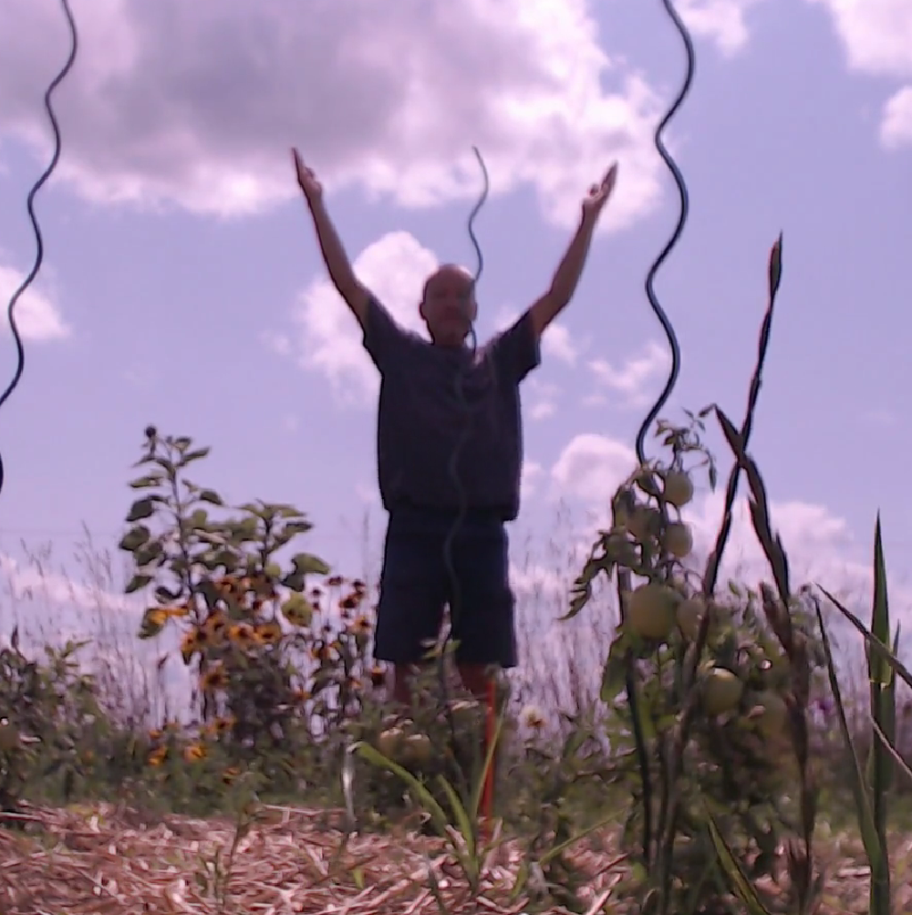
Eurythmy
Eurythmy is an expressive movement art originated by Rudolf Steiner in the early 20th century. Primarily a performance art, it is also used in education, as part of anthroposophic medicine for claimed therapeutic purposes, and in Biodynamic agriculture: an approach to farming that goes beyond organic farming by incorporating spiritual, holistic, and ecological principles into agricultural practices. When performing eurythmy the melody is conveyed through expressing the arm gestures of the actual tones.
Notes:
expressive movement art originated by Rudolf Steiner
Used in Biodynamic agriculture (rheinau)
It has different arm gestures that represent letters

Slide 5
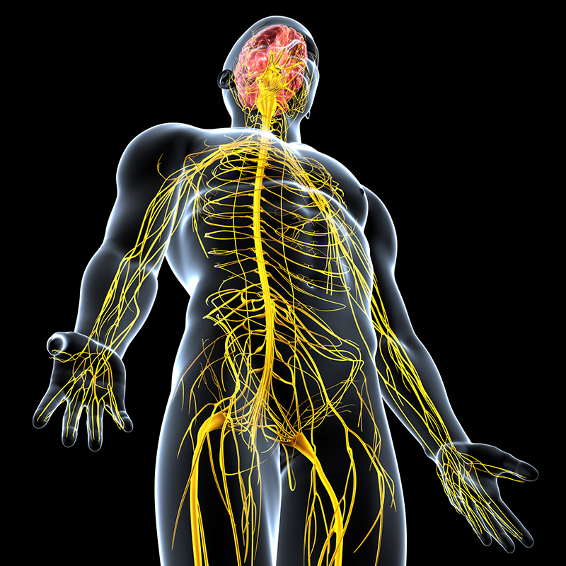
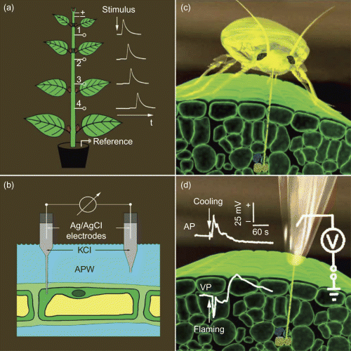
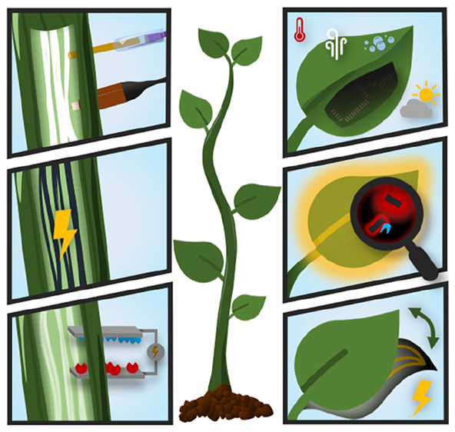
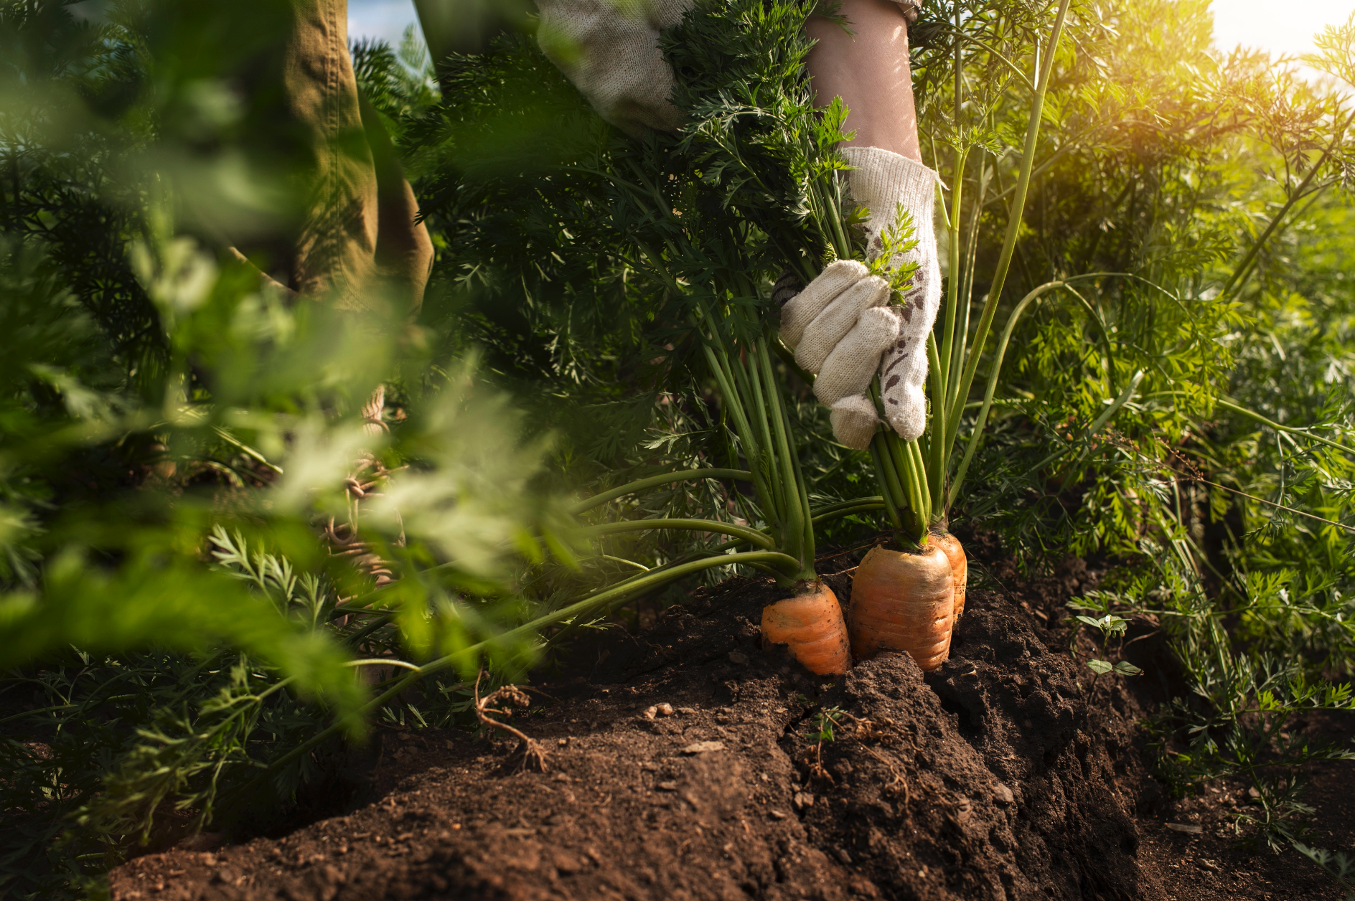
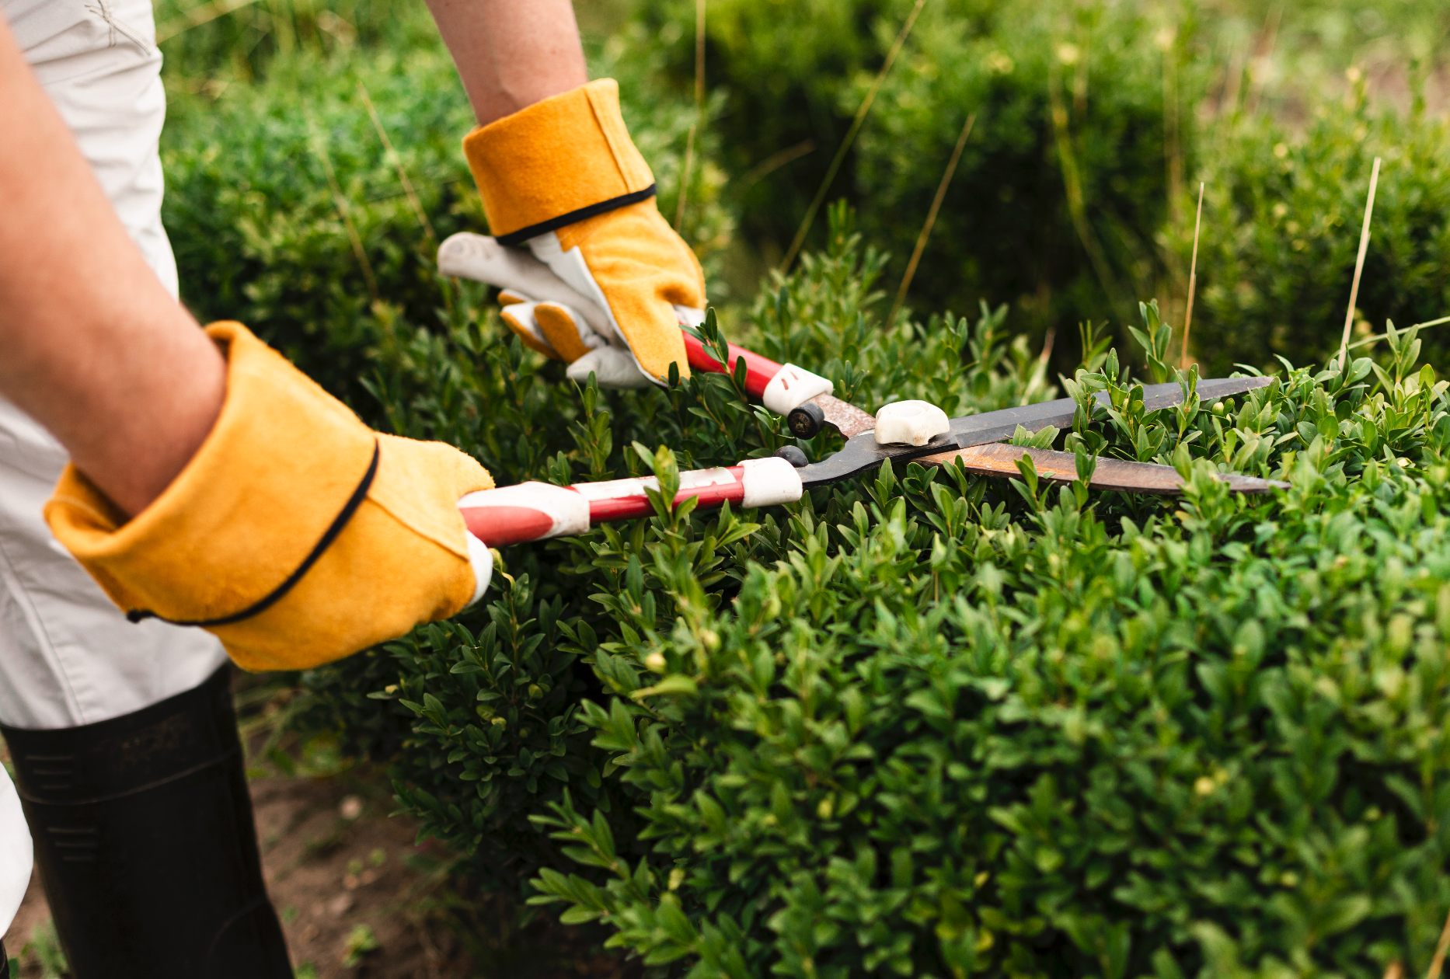
Plant Electrical Signal
Bioelectricity
Functions
Living organisms have evolved complex signaling networks to drive appropriate physiological processes in response to changing environmental conditions.
Electrical signals regulate growth, gas exchange, respiration, variation of photosynthesis and transpiration, and modification of gene expression.
Notes:
Living organisms have electricity signaling networks in response to the enviroment
In plants, this signals regulate different processes as growth, photosynthesis or even gene expression

Slide 6
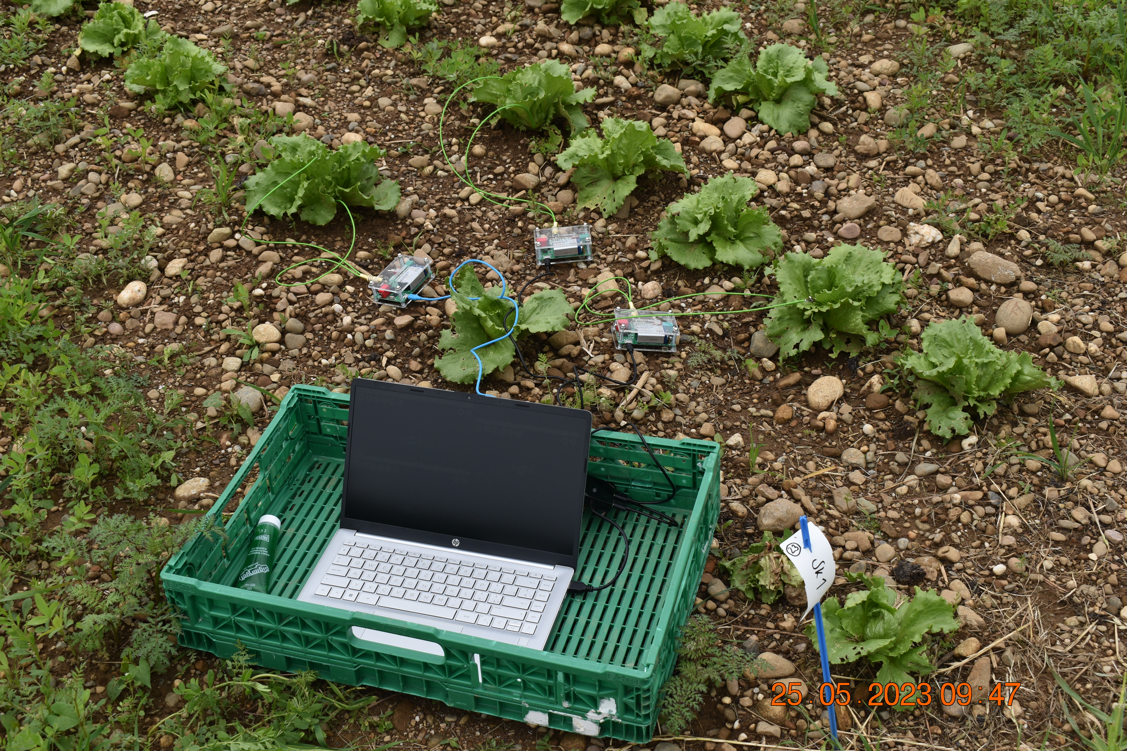
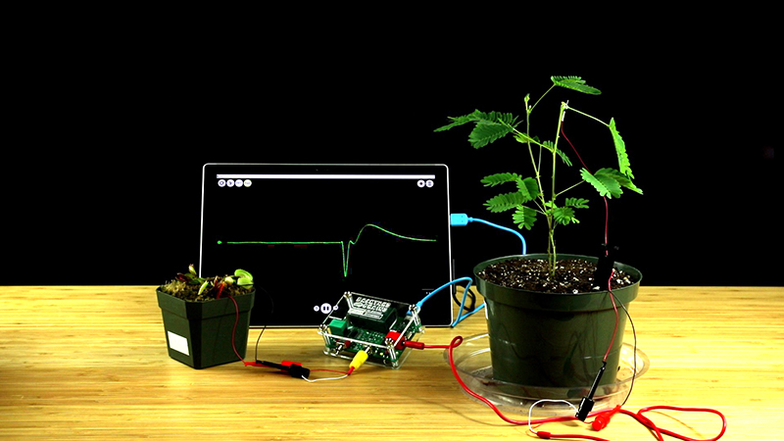
How to Measure
Extracellular Recording
Surface measurements are well known from animal electrophysiology (ECG/EEG) and are based on measurements of the total sum of bioelectrical activity in large groups of cells. These recordings involve the placement of electrodes on the plant surface and soil to provide valuable information about the bioelectrical activity of the plant, while maintaining its physiological integrity.
https://backyardbrains.com/products/plantspikerbox
Notes:
We measure bioelectrical activity in large group of cells
We place electrodes in the Surface and soil
Highly recommend to visit backyardbrains webpage

Slide 7
Research Questions
01
Do plants react to eurythmy?
Do plants react differently to Eurythmy for the first time than when they are used to it?
02
Do plants react differently between several eurythmy movements in a row?
03
Do plants react differently between different eurythmy gestures?
04
Notes:
Luis, Josephine have worked in the first question
Extending the study with the following questions

Slide 8
02
Methodology

Slide 9
Methodology
Measurements
Modeling
01
04
Preparation
Evaluation
02
05
Featurization
03
Explanation of the data collection process
Modeling, selection and fine-tuning
Data organization, cleaning and tuning
Analysis of the evaluation metrics
Extraction of characteristics from each wave file

Slide 10
Methodology
01
Measurements

Slide 11



Measurements
Salad
Tomato
Basil
A-G-D
A-G-D-O
A-G-D-L
Eurythmy Gestures
(4x times each)

Slide 12


Procedure
Eurythmy
Control
The voltage of 3 plants is measured while an expert performs the eurythmy gestures on them
The tension of 3 plants far away from the expert but in the same orchard is measured

Slide 13

Data Points
A
G
D
O
1 Tomato Folder Point
6plants x 4gestures x 4times=
96 data points
1x
2x
3x
4x
Notes:
- Without any statistical trick we have lot of data points for each measurement

Slide 14
Folder Points
7400 points (Aug 16)
2304 data points
32folders x 72files=
3136 data points
32folders x 98files=
1960 data points
20folders x 98files=
Notes:
Half of them for the questions that are not the first one
Way of increasing

Slide 15
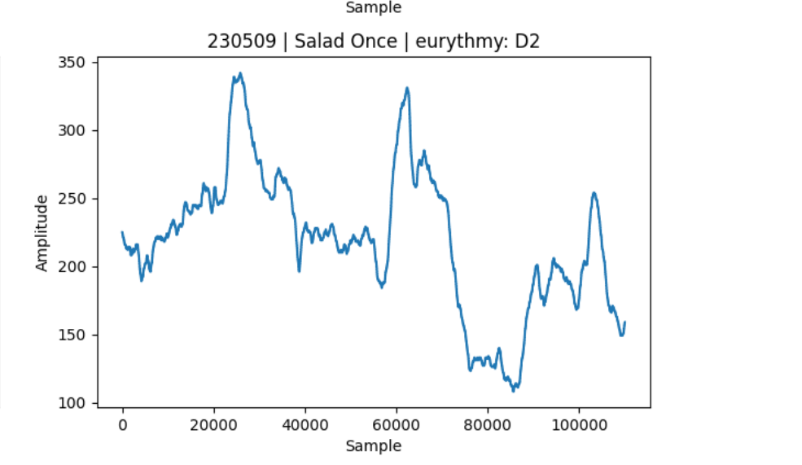
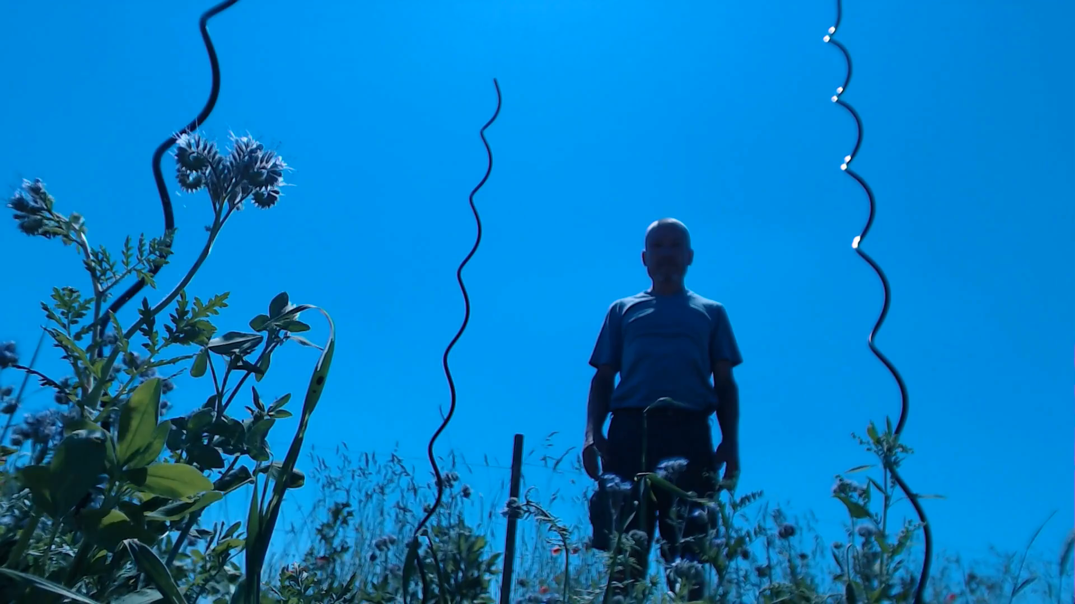
Files
Wav
Mp4
The Wav files are datapoints and represent the plant voltage over time
The Mp4 files help us to detect the gesture and timing of eurythmy

Slide 16
Methodology
02
Preparation

Slide 17


Synchronization
Intersection
10:50
10:51
10:52
10:53
10:54
10:55
10:56
10:57
10:58
10:59
…

Slide 18
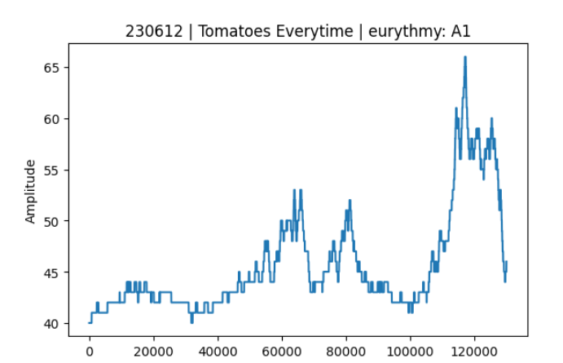
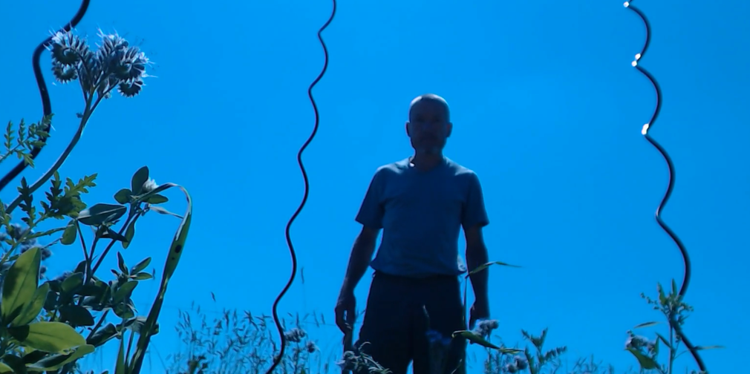
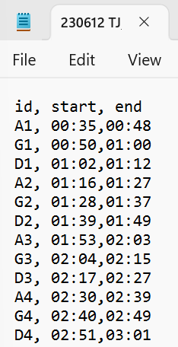
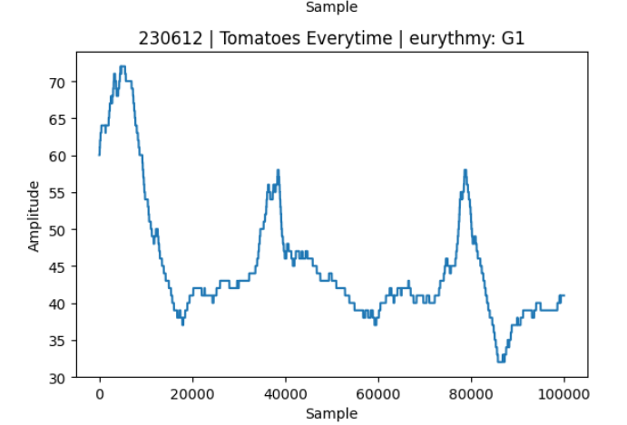
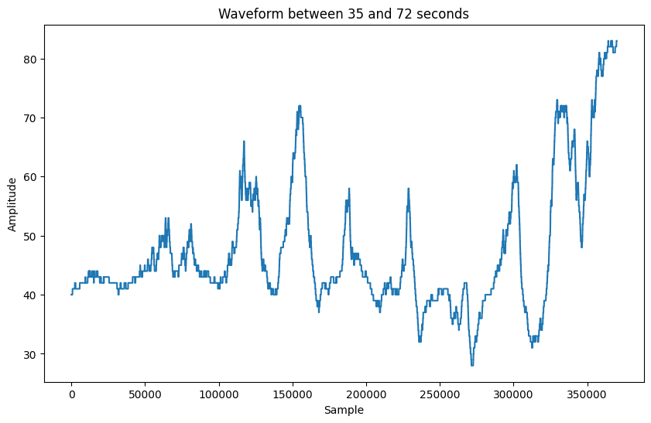
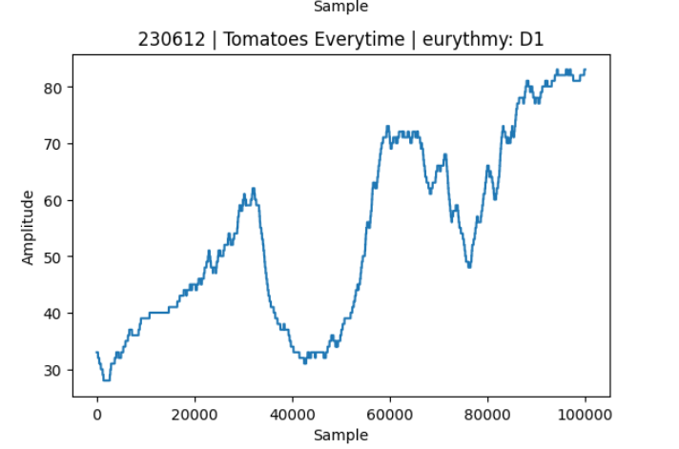
Trim
Labelling the video
A
G
D
84/84 folders labelled (Aug 21)
speed: 7-8 folders/hour
Notes:
Prefered to go this manual path and now I have to suffer the consequences
Speed is labelling 7-8 videos per hour

Slide 19
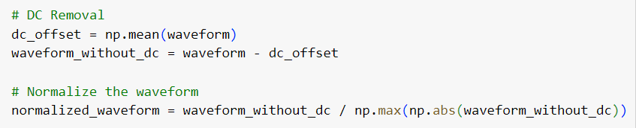
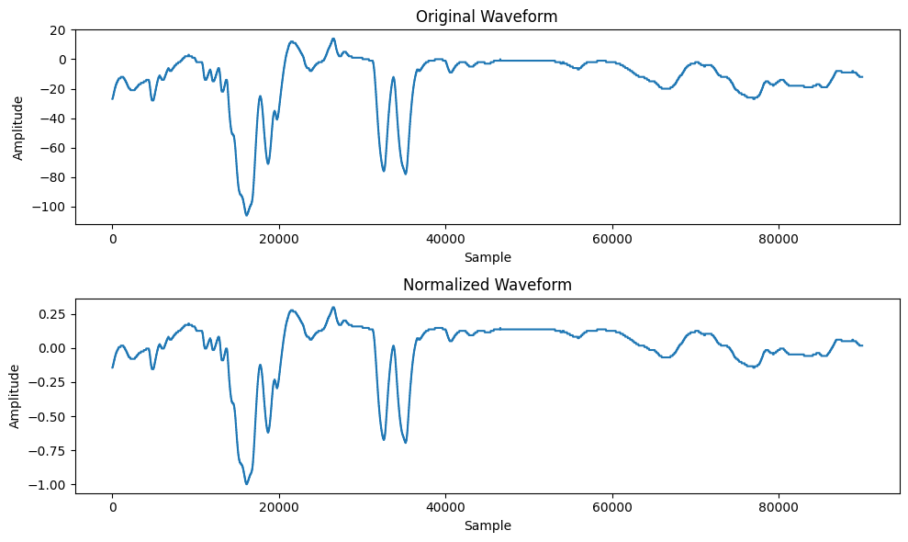
Normalize the waveform + DC removal
Standardization
Notes:
- It is needed to compare, backyard brains

Slide 20
Next Steps
Print all Wav files to find outliers
Keep labeling the next files
Extract the Features
Notes:
- the basil that I bought died

